Slide 1

RU Hacks 2019
Freshest Hack Challenge

Slide 2

What is iTradeNetwork?
Copyright © iTradeNetwork 2019

Slide 3
(Arguably) the most interesting company you’ve (maybe) never heard of.

Slide 4

HQ: San Francisco Bay Area (California)
5,000+ Customers (brands you’d easily recognize)
Deployed Globally
145 Employees
Founded in 1999
Copyright © iTradeNetwork 2019

Slide 5
Some of what we do…
Copyright © iTradeNetwork 2019

Slide 6

About iTradeNetwork: Product Portfolio

Slide 7

iTradeNetwork’s OMS (Order Management System) is the industry standard for fully integrated, end-to-end perishables order management.
Meet
OMS
(Order Management System)
7

Slide 8



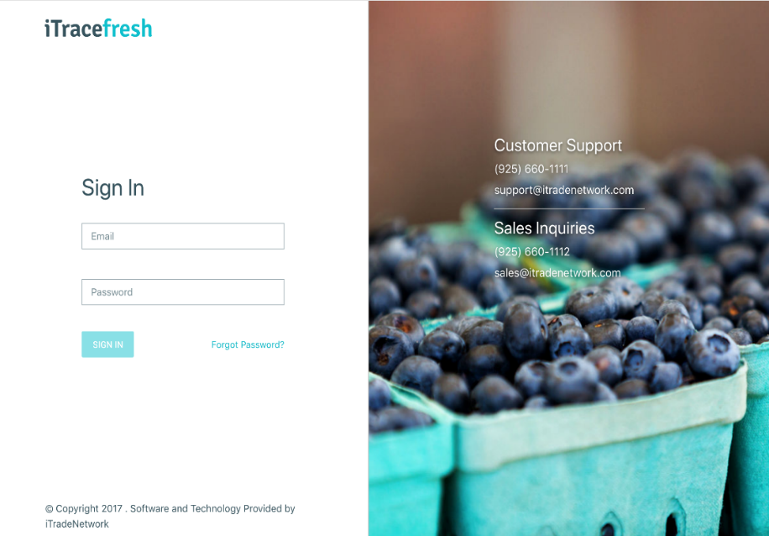
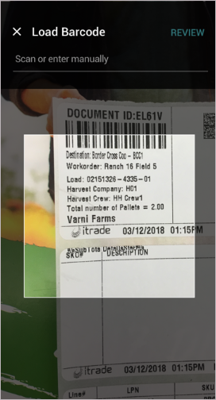
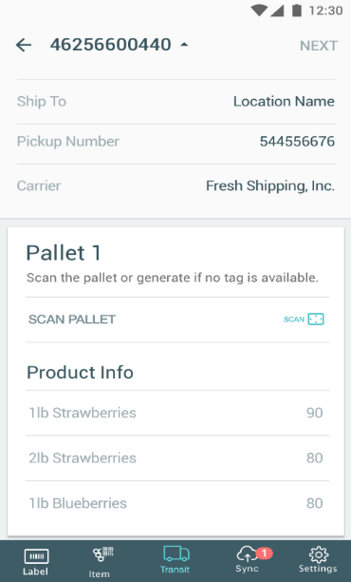
Ensure food safety and compliance on the industry’s leading food traceability software.
Meet
iTracefresh
8
Copyright © iTradeNetwork 2019

Slide 9
The Freshest Hack
Challenge…
Copyright © iTradeNetwork 2019

Slide 10
The Freshest Hack
The team that demonstrates and executes the most innovative feature, concept or module that could be applied to any of products will win a prize! The feature, concept or module does not need to represent the entirety of your hackathon project, but it should be inspired by, or a functional piece of, your larger hackathon project.

Slide 11

Judging Criteria
Innovation
How unique is your idea?
Return on Investment
Can your idea make money and make the world a better place?
Quality and Polish
Is your idea cool and does it work?
Copyright © iTradeNetwork 2019

Slide 12
The iTrade
Challenge Prizes…
Copyright © iTradeNetwork 2019

Slide 13

Winning Team
$250 Visa gift card (per team member)

